Slide 1

Bangladesh Army University of Engineering & Technology
Department of Computer Science and Engineering
EEE 2261: Electrical Drives and Instrumentation
Winter 2025 Semester
Lecture-02 & 03
Course Teacher
S. M. Ashik Al Mashrafi
Lecturer, EEE, BAUET
Total Credit: 3.0 Credit Taking: 3.0

Slide 2
Course Content
Chapter | Topics
Introduction | Three phase circuits, alternators and transformers, principles & operation of DC Machines, synchronous, induction, universal and stepper motors, thyristor and microprocessor-based speed control of motors
Instrumentation Amplifiers | Differential, logarithmic, and chopper amplifiers, frequency and voltage measurements using digital techniques, recorders and display devices, spectrum analyzers and logic analyzers, data acquisition and interfacing to microprocessor-based systems;
Transducers | Terminology, types of transducers, principles and applications of photovoltaic, piezoelectric, thermoelectric, variable resistance and opto-electronics transducers. Noise reduction in instrumentation

Slide 3
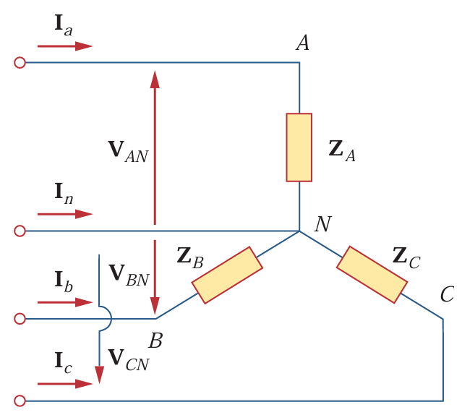
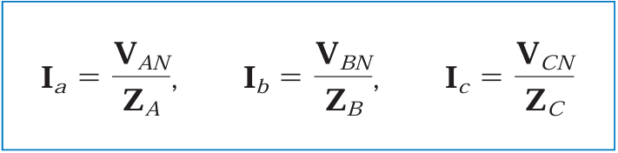
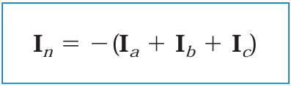
Unbalanced Three Phase System
An unbalanced system is due to unbalanced voltage sources or an unbalanced load.
The line currents are determined by Ohm’s law as
This set of unbalanced line currents produces current in the neutral line, which is not zero as in a balanced system.
Fig. 1: Unbalanced three-phase
Y-connected load.

Slide 4
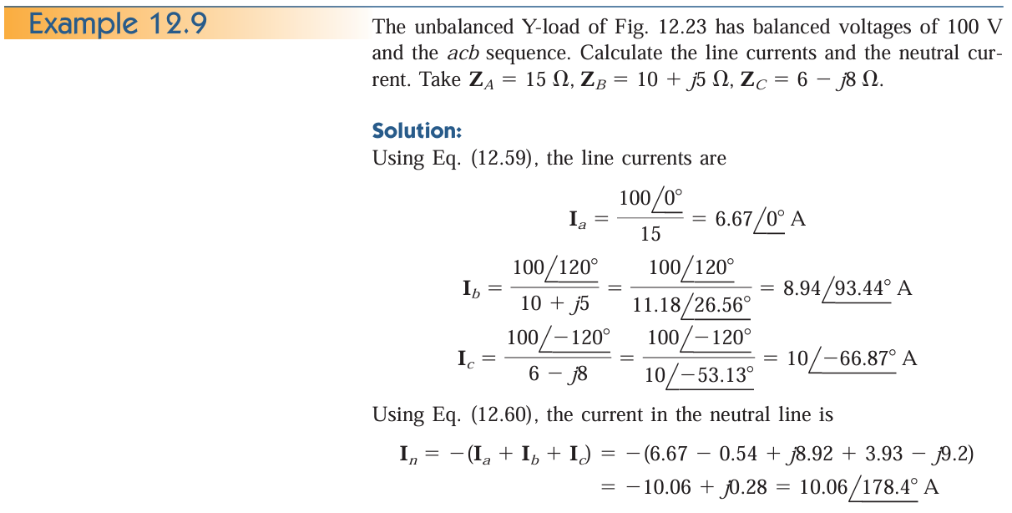
Unbalanced Three Phase System (contd.)

Slide 5
Thank You
For Your Attention

